Slide 1
Employee Data Analysis using Excel
STUDENT NAME: AFRIN.S
REGISTER NO: 312217981, 4FD738A6479A94BBE5546F9A63999C45
DEPARTMENT: B.COM [Commerce]
COLLEGE: ST.ANNE’S ARTS AND SCIENCE COLLEGE

Slide 2

PROJECT TITLE
EMPLOYEE PERFORMANCE ANALYSIS USING EXCEL
This Photo by Unknown Author is licensed under CC BY-NC-ND

Slide 3
AGENDA
Problem Statement
Project Overview
End Users
Our Solution and Proposition
Dataset Description
Modelling Approach
Results and Discussion
Conclusion

Slide 4

PROBLEM STATEMENT
EMPLOYEE PERFORMANCE ANALYSIS:
The performance analysis are to be analysed
so that the organization or employer’s can value their
employee’s hard work and their passion towards the work
and with that note the organization can provide increment
or bonus which is deserved for them.

Slide 5

PROJECT OVERVIEW
Employee’s performance analysis means to identify the employee
categories such as gender, division, business unit, supervisors, employee type,
etc., so that it will be an easy job to the organization to respect each
and every person’s hard work. There is an pictorial representation
based on the employee’s details.
.

Slide 6



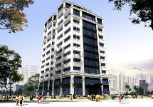


WHO ARE THE END USERS?
The person who will get benefited by this problem are
1. Organisation
2. Employee’s
3. HR Manager’s
4. Private Industries
5. Employer’s
This Photo by Unknown Author is licensed under CC BY-SA

Slide 7

OUR SOLUTION AND ITS VALUE PREPOSITION
Filter - This was used to sort out the employee’s details with one touch.
Formula – The formula’s are used to ascertain the values or to find out employee analysis.
Pivot table – This is to show an easy way of understanding the concept or purpose of performance analysis.
Slicer – Used to slice the data in pivot table by making an quick understanding.
Graph – This was to show a pictorial representation of the data given of the employee’s to understand better.

Slide 8
Dataset Description
Employee dataset – Kaggle, Features – 26, Features taken – 9
The considered features are,
1. Employee ID - Numerical values
2. First & Last Name - Text
3. Business Unit - Text
4. Employee Type - Text
5. Employee Status - Text
6. Gender - Text
7. Performance Level - Text
8. Current employee rating - Numerical values

Slide 9

THE "WOW" IN OUR SOLUTION
FORMULA USED:
=IFS(Z2>=5,”very high”,Z2>=4,”high”,Z2>=3,”medium”,TRUE,”low”)
3/21/2024 Annual Review
9

Slide 10
MODELLING
DATA COLLECTION - Collected employee data from edunet dashboard to analysis employee performance.
FEATURES CONSIDERED – Employee ID, First name, Last name, Business unit, Employee type, Employee status, Gender, Performance level, Current employee rating.
FILL COLOUR – Applied yellow fill for the features or data collected to analyse the employee performance level.
CONDITIONAL FORMATTING – Used to highlight the missing values and to remove the blank value using filter.
FORMULA – Used a formula to ascertain the employee performance level by converting numerical values into text.
PIVOT TABLE – Inserted a pivot table to show the employee performance with different business unit by using the filter gender to have an easy way of understanding.
10

Slide 11
SLICER – Used to slice the employee type data to find out the contract, full-time, part-time employee’s.
GRAPH – Used pictorial representation (GRAPH) to show an easy way of understanding the concept of tracking employee performance analysis.
TREND LINE – Used trend line to show the very high, high,medium level of performance done by the employee’s.

Slide 12
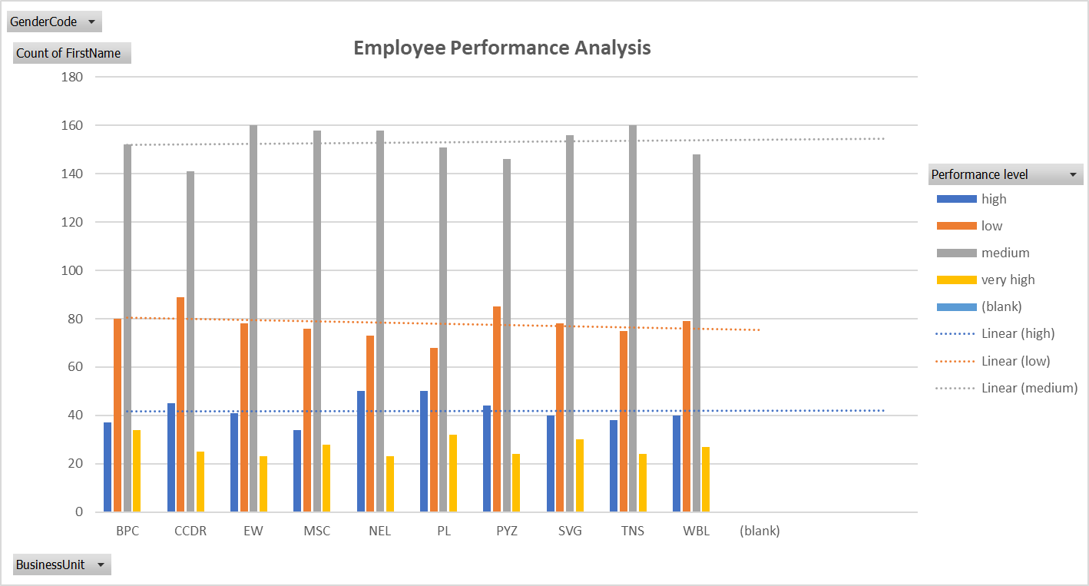
RESULTS
12

Slide 13
CONCLUSION
To conclude this analysis in full, the employee’s who are performing medium level are more than the high or very high employee’s level resulting that we have to motivate the employee’s to perform their work to their fullest by providing them the deserved increment and bonus so that there will be two benefits to the organization, First, employee’s hard work and to satisfy the needs of an customer.
THANK YOU

